Slide 1

May Review 2020
AI-003: Predictive Diagnostics for Multi Jet Fusion and Industrial Digital Printer
Two Investigations Underway:
Mfg 4.0 Methods to Ink Cartridge Ship Gate & Reliability (IET)
Ink Bag and Cartridge Inspection
NTU PI Tan Rui NTU Co-PI Sinno Jialin Pan | HP PI Daren Ho HP PI Marie Vans

Slide 2
Hiring Status (if any)
Designation (PO, RA, RF) | Status (e.g. job advert posted, pending applicants, interviewing, pending nationality waiver, pending offer, pending work pass approval) | Name of candidate (if identified)
RA | Joined on Sep 16th 2019. | Zhou Siyuan
RA | Joined on Feb 2020. | Chen Jiale
Senior RF | Joined on Dec 2019. | Dr. Le Van Duc
PO | Joined on Aug 5th 2019. | Deng Yue
PO | Joined on Sep 4th 2019. | Yang Qiping

Slide 3
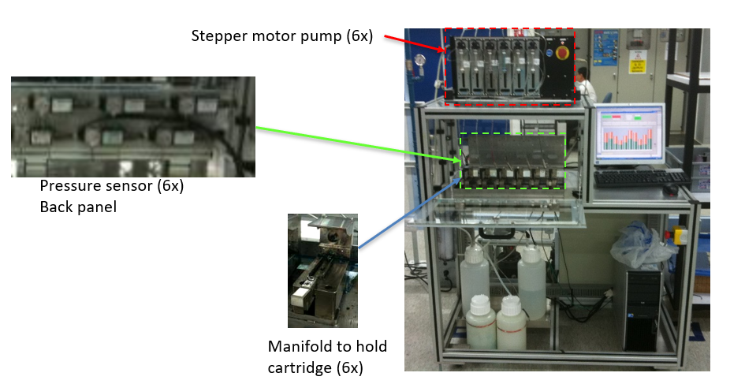
Background and Approach Overview
Pump
Background: IETs are sensitive equipment, easily affected by human behavior, machine condition.
Our objective: Get rid of retest/repull but can still differentiate false positives and true positives
Proposed Solution
Pressure sensor
Manifold
Ink Extraction Tester (IET)
ML-based profile classifier
Air bubble detection
Product or tester failure?

Slide 4
ML-based Profile Classifiers
We manually labelled profiles to create training samples, but it is very time-consuming.
We built various ML classifiers (e.g., CNN, decision tree and MVAE) using manually labelled data but the accuracy is limited due to a small number of training samples.
We develop two feature engineering techniques based on prior domain knowledge for data labeling.
Profile analysis and K-means based labelling
Profile segmentation featuring based labelling
Method name | Product recall | Product precision | Tester recall | Tester precision
Decision Tree | 67% | 50% | 58% | 70%
CNN | 26% | 50% | 70% | 58%
MVAE | 58% | 69% | 81% | 65%

Slide 5
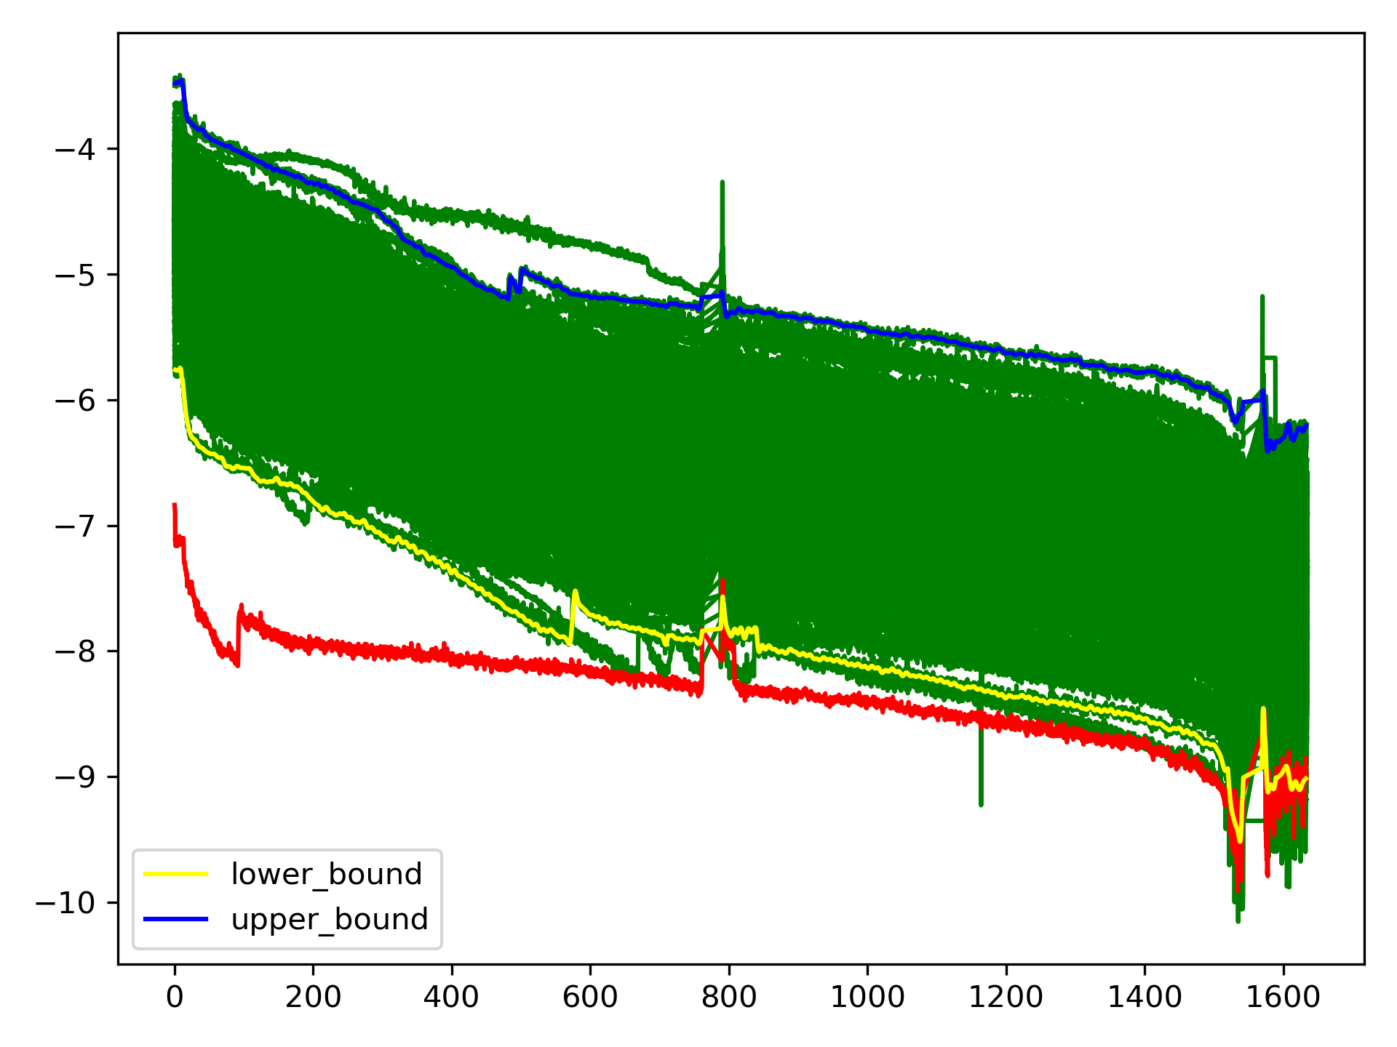
Profile Analysis and K-means based Labelling
Observations on profiles from the same configuration
Less variation in length and curve shape
Compact, well-posed spatial clusters
Many normal profiles (e.g., 592,526 from 18_02 to 19_11)
Proposed Method
Determine upper and lower bound of normal profile clusters
Use K-Means to group profiles into multiple clusters based on their distances to two bounds
Label profiles which are far away from upper/lower bound as product failures.

Slide 6
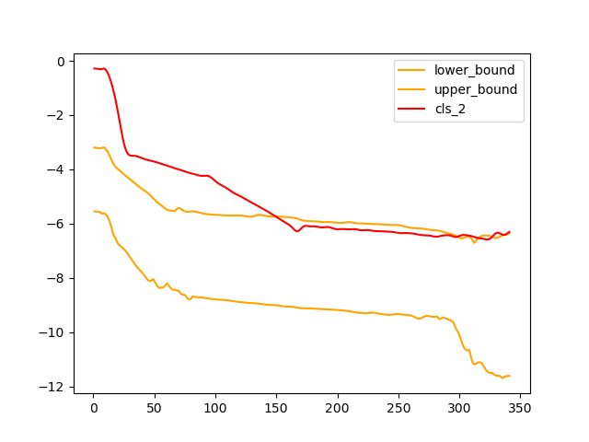
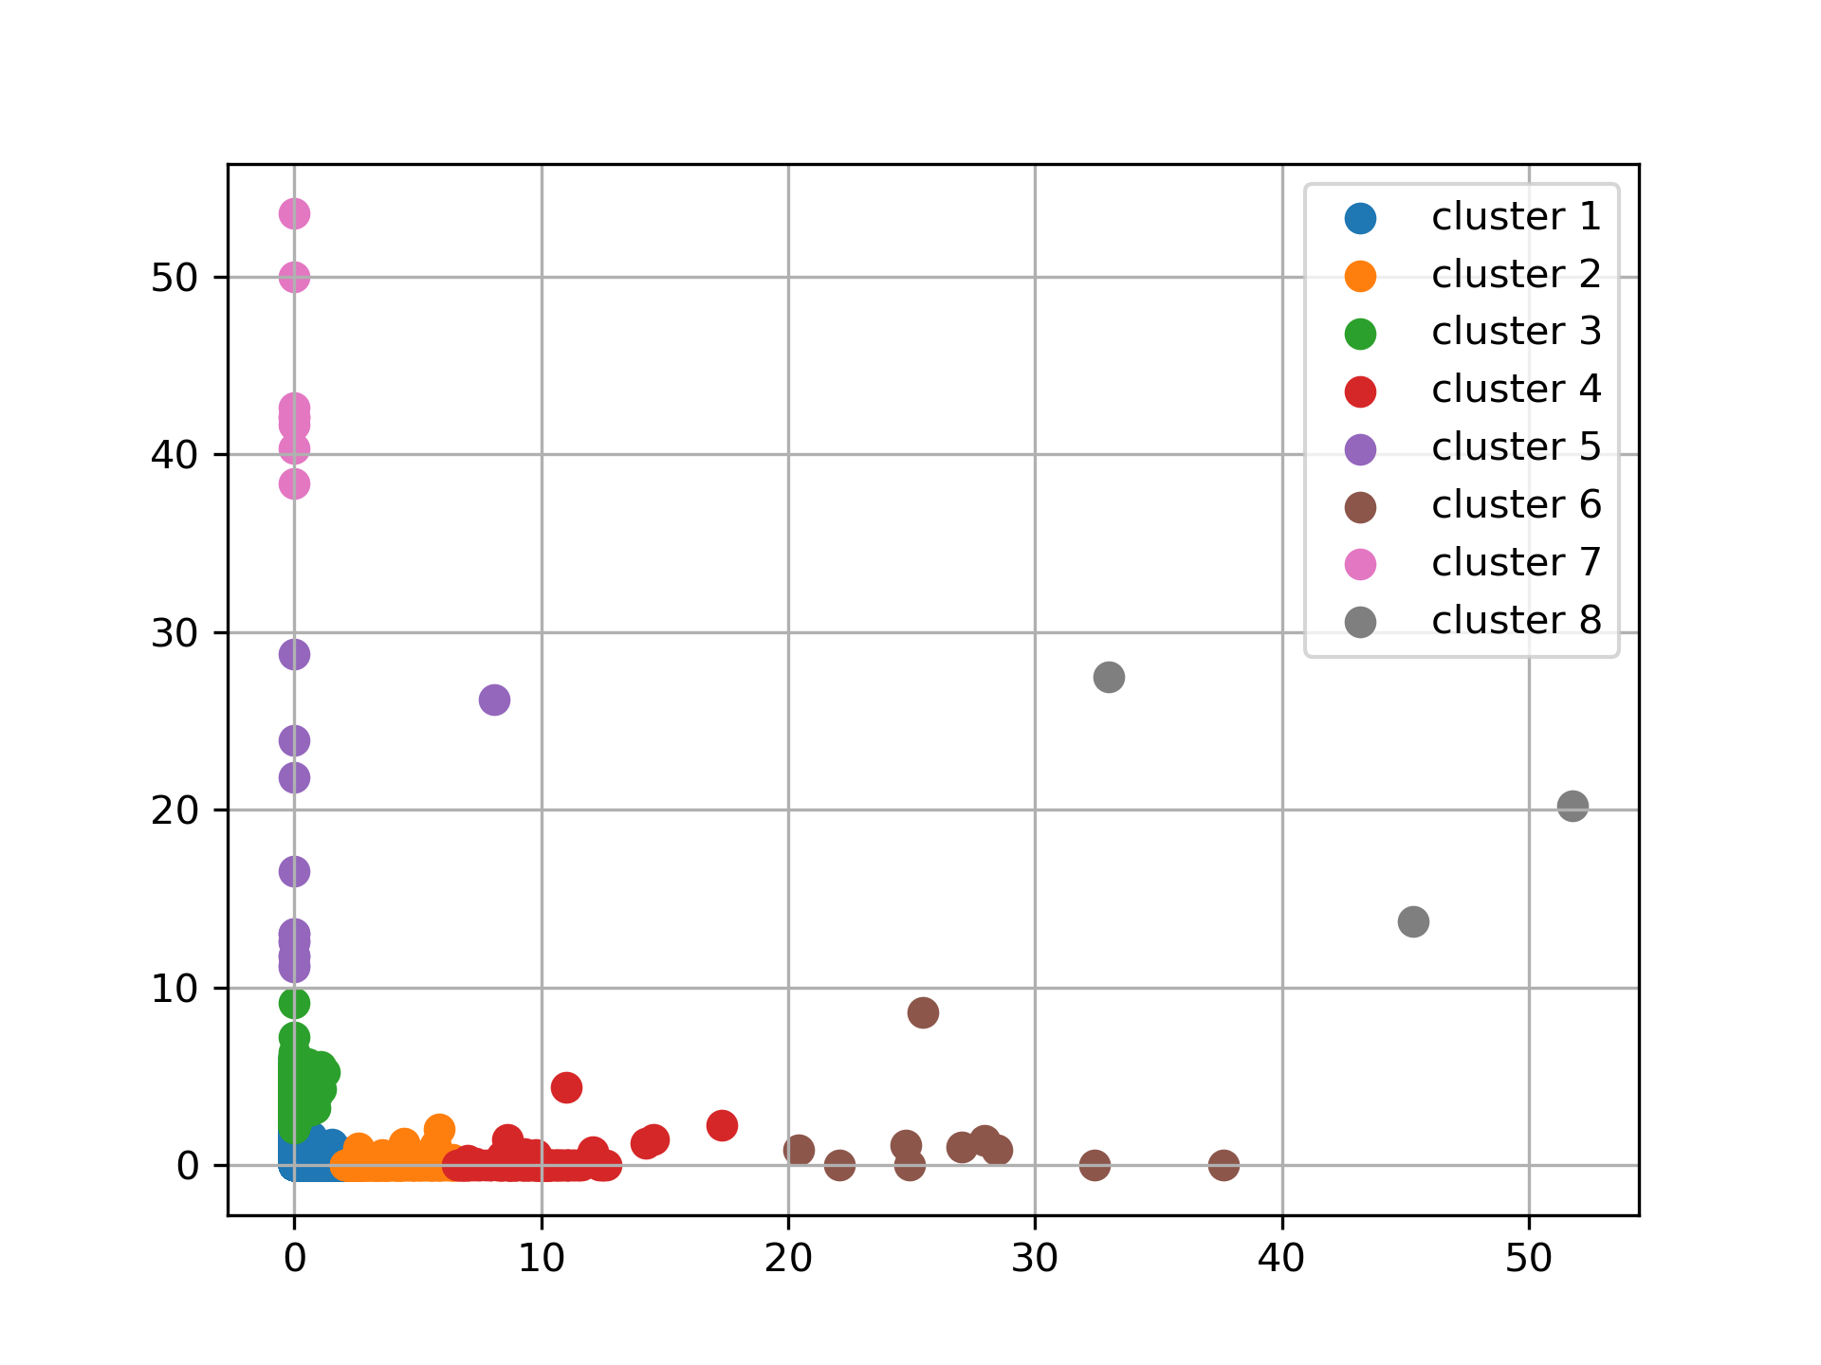
Profile Clustering using K-means
High distance
Pressure
Time (sec)
Closest to normal
Far from normal

Slide 7
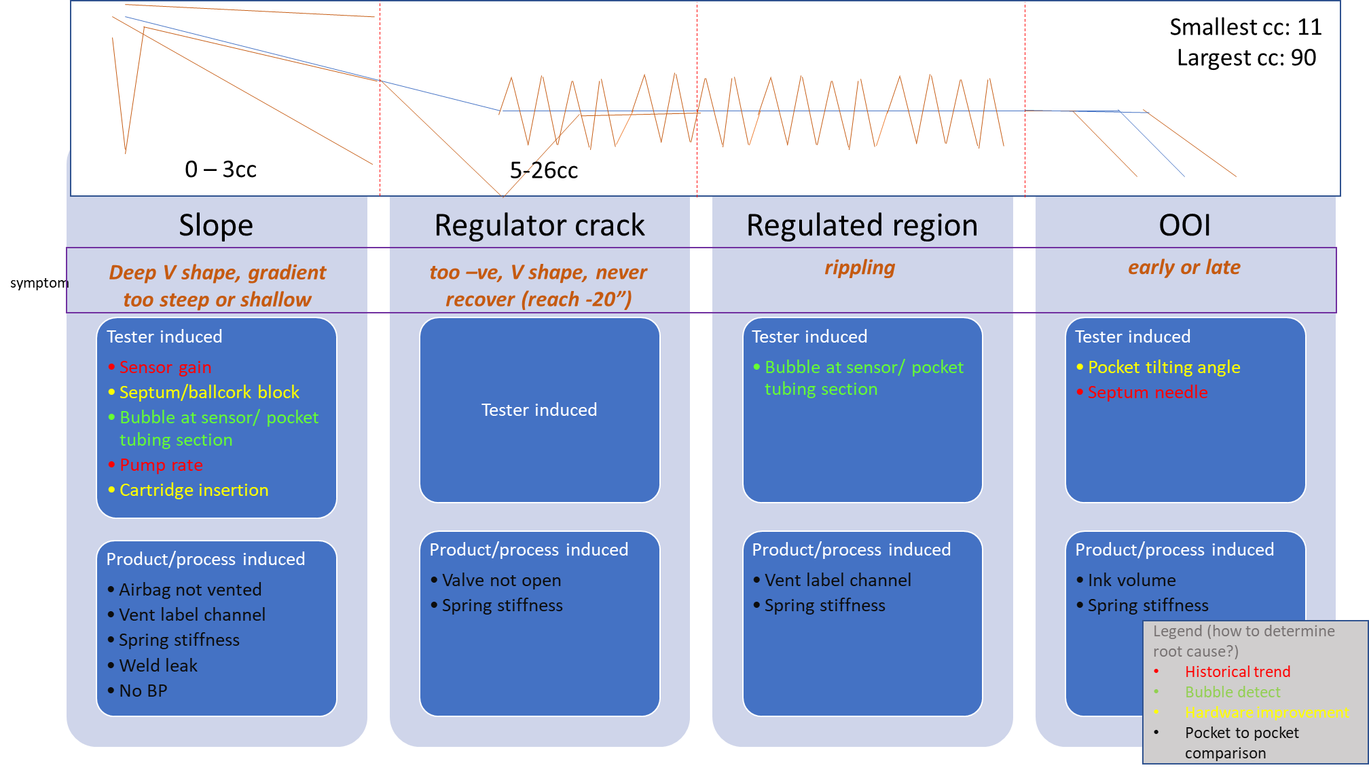
Profile Segmentation Featuring based Labelling

Slide 8
Air Bubble Detection for IET

Slide 9
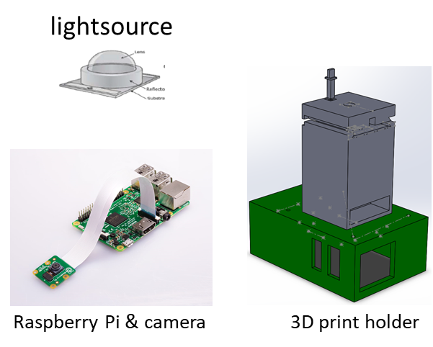
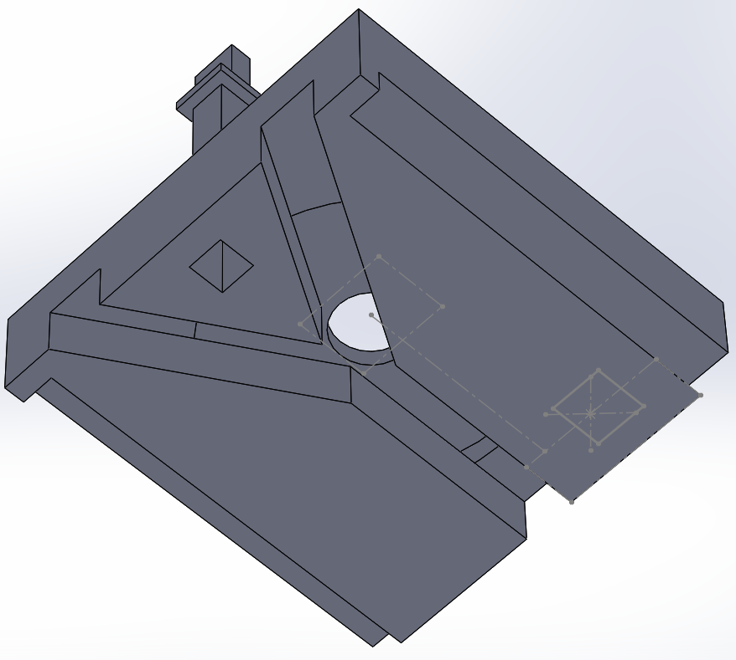

Air Bubble Detection: Setup Configuration and Costing
Cost breakdown
 | Unit cost | Qty
Raspberry Pi | 100 | 6
camera | 35 | 6
Light source | 25 | 6
Network switch | 50 | 1
Misc | 50 | 1
Y-joint to be
place here
6x for 6up
pocket
Total amt for 1 IET = $1060
IET PC
Network switch

Slide 10
Image Recognition Methods
Gaussian Model Method (GMM)
Pros
Can localize and measure the size of air bubbles at pixel levels
Not need to label images
Cons
Long inference latency
Pixel level classification is sensitive to lighting and vibration
Deep Neural Network (DNN)
Pros
Short inference latency (20x shorter than GMM)
Reduced computation complexity
Cons
Cannot measure the bubble’s size
Need labelled images to train DNN

Slide 11
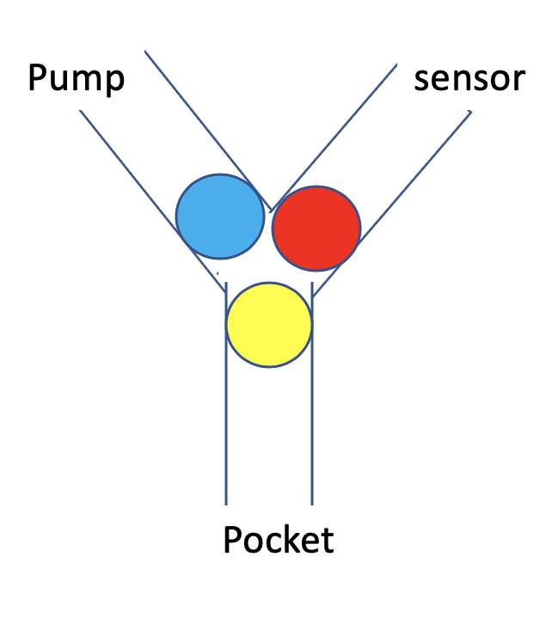
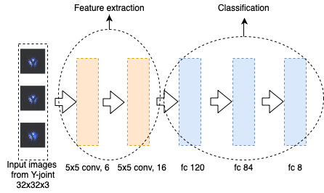
DNN Approach
Labeling method
Separately label three parts of Y-joint
e.g., 101 where 0: no bubble and 1: bubble
DNN model
Part 1
Part 2
Part 3
98.3%

Slide 12
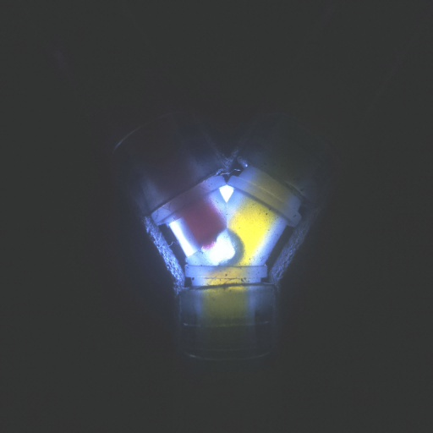
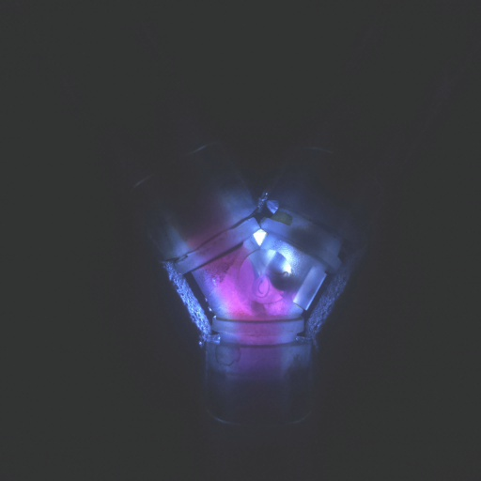
Current Challenges & Future Work
Challenges on DNN training and testing
Hard to differentiate clear water and air bubble
Pending for field testing to validate actual performance
Ongoing investigations to reduce system complexity and speed up computation
Develop a new testbed consisting of multiple low-power cameras and one computing edge node (e.g., a Raspberry Pi with Intel Duo Stick).
Dynamically split DNN model between low-power cameras and edge node over wireless channels to reduce power consumption of cameras.
Wireless power transfer and renewable energy methods to charge cameras’ batteries.
Bubble
Bubble
Clear water
Notes:
Currently, there are two situations will have clear water.
1. During flushing water step. (Clear water’s colour is very similar with air bubble)
2. When the ink is extracted immediately after flushing water, there will be some residual clear water in the tube.(clear water colour is not very similar with air bubble)
Because we do not need to detect the clear water, we just need detect the air bubble, so the clear water should be seen as ink in our method. My current idea is using DNN to train and test both of the two stage images by DNN method. (Image label is only focus on the bubble)
If we have more larger image dataset and show this method do not work well in the future, I think we may separate detection as two phase, train the DNN based on situation. (Flushing water phase and extract ink phase)

Slide 13
Ink Bag and Cartridge Inspection

Slide 14
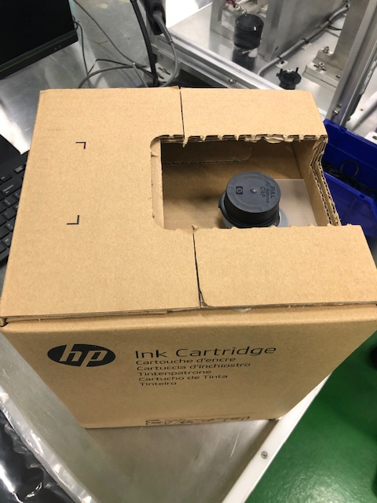
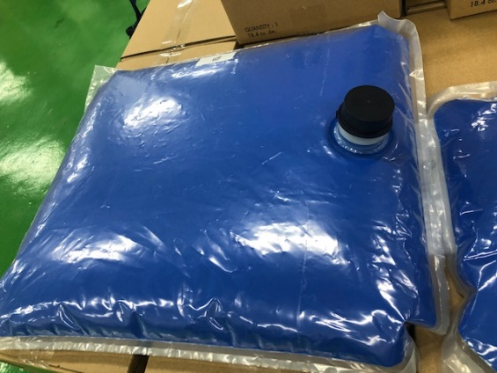
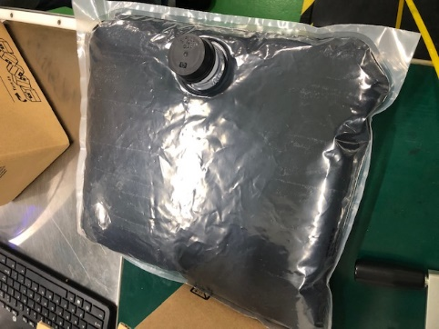
Background and Objectives
Issue statement
Dependency of human to inspect ink cartridge quality at manufacturing line produced multiple issues:
Consistency and speed (caused by fatiqueness)
Knowledge retention and training
Objective
Develop automate visual inspection of Ink cartridge for GSB product using ML/DL & IoT technique
Two focusing areas
Bubble present (100% inline inspection)
Bubble volume (Audit inspection)
Final packaging
Inkbag to be inspected
(size: 0.2, 0.5 and 1 liter)
Notes:
Currently, there are two situations will have clear water.
1. During flushing water step. (Clear water’s colour is very similar with air bubble)
2. When the ink is extracted immediately after flushing water, there will be some residual clear water in the tube.(clear water colour is not very similar with air bubble)
Because we do not need to detect the clear water, we just need detect the air bubble, so the clear water should be seen as ink in our method. My current idea is using DNN to train and test both of the two stage images by DNN method. (Image label is only focus on the bubble)
If we have more larger image dataset and show this method do not work well in the future, I think we may separate detection as two phase, train the DNN based on situation. (Flushing water phase and extract ink phase)

Slide 15
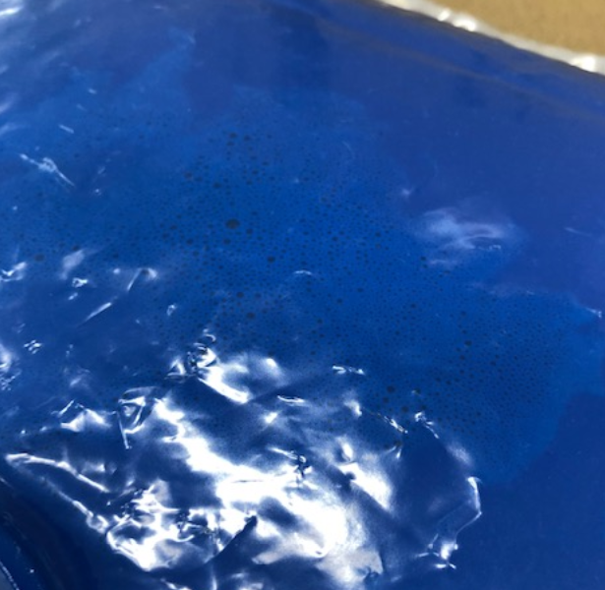
Proposed System Overview
Bubble
Potential challenges
Large view area (from 20*20 cm² to 50*50 cm²).
Reflection of the light source will block the bubble in the ink bag.
Bubble might spread to multiple clusters
Proposed solution
Use multiple cameras to capture different parts of ink bag
Inspect the ink bag from different view angles
Reduce the impact of the light reflection
Build deep learning models to detect to air bubble size and volume
Camera
node1
Camera
node2
Camera
node3
Edge device like raspberry Pi or PC
Notes:
Currently, there are two situations will have clear water.
1. During flushing water step. (Clear water’s colour is very similar with air bubble)
2. When the ink is extracted immediately after flushing water, there will be some residual clear water in the tube.(clear water colour is not very similar with air bubble)
Because we do not need to detect the clear water, we just need detect the air bubble, so the clear water should be seen as ink in our method. My current idea is using DNN to train and test both of the two stage images by DNN method. (Image label is only focus on the bubble)
If we have more larger image dataset and show this method do not work well in the future, I think we may separate detection as two phase, train the DNN based on situation. (Flushing water phase and extract ink phase)

Slide 16


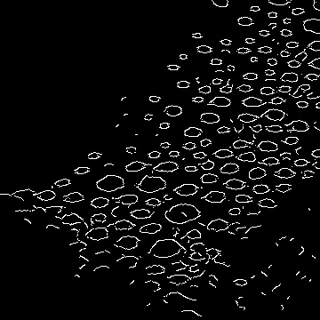
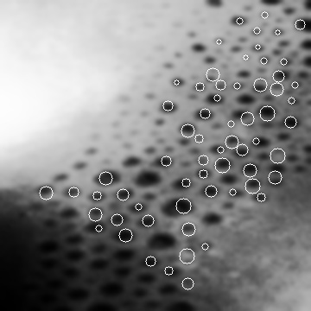
Preliminary Experiments and Results
Gaussian Blur
Canny edge detection
Hough circle detection
A traditional computer vision (CV) method
Transform the RGB image into grayscale image and use gaussian blur method to eliminate the noise of the image.
Use canny edge detection to extracts the edges of bubble in the image.
Based on the edge map, we use Hough circle detection to detects bubble as circles in image
Results

Slide 17
Ongoing Works
Traditional CV method can only detect air bubbles with round extracted edge on images
We are exploring the potential combination of DNN models and traditional CV techniques
Apply traditional CV techniques to label images which are then used to train DNN models
Investigate distributed sensing and image processing techniques to improve detection accuracy and reduce the computation complexity.
Built a testbed system with multiple low-power and recourse-constrained cameras
Notes:
Currently, there are two situations will have clear water.
1. During flushing water step. (Clear water’s colour is very similar with air bubble)
2. When the ink is extracted immediately after flushing water, there will be some residual clear water in the tube.(clear water colour is not very similar with air bubble)
Because we do not need to detect the clear water, we just need detect the air bubble, so the clear water should be seen as ink in our method. My current idea is using DNN to train and test both of the two stage images by DNN method. (Image label is only focus on the bubble)
If we have more larger image dataset and show this method do not work well in the future, I think we may separate detection as two phase, train the DNN based on situation. (Flushing water phase and extract ink phase)

Slide 18
Project’s strategy and approach to IP/publication E.g. 70% publish or 20% file TD/patent, 10% support new product development
In the next year, publish two papers on prestigious conferences; file two TDs; complete the deployment of IET project prototype.
Hypothesis for how this project will impact the HP digital manufacturing business? (For HP PI’s completion)
IET project reduce operation costs due to retest (resources, material, quality field escapes, etc.) Apply to automatic inspection of ink bag (exploring) Predictive diagnostic – yield improvement with build quality assurance
KPI | Status (NIL, In progress – target date to apply/ publish, filed, published)
Technical Disclosures/ Patents | None.
Papers | 1 paper published on Nov 10th 2019: Challenges of Privacy-Preserving Machine Learning in IoT. Mengyao Zheng, Dixing Xu, Linshan Jiang, Chaojie Gu, Rui Tan, Peng Cheng. The 1st Intl Workshop Challenges in AI & ML for IoT (AIChallengeIoT) with SenSys'19, November 10, 2019, New York, NY, USA. - Extended version of this work submitted to IEEE IoT Journal (A+)
Others (e.g. support new product)

Slide 19
Thanks for your attention!

